Slide 2
PLEASE PAUSE HERE

Slide 3
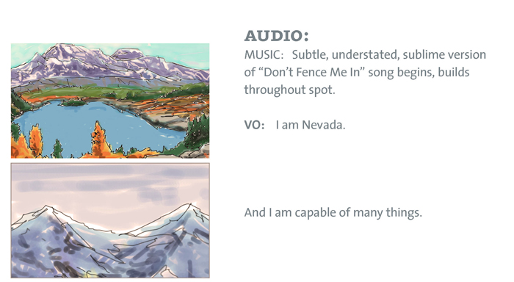

Slide 4
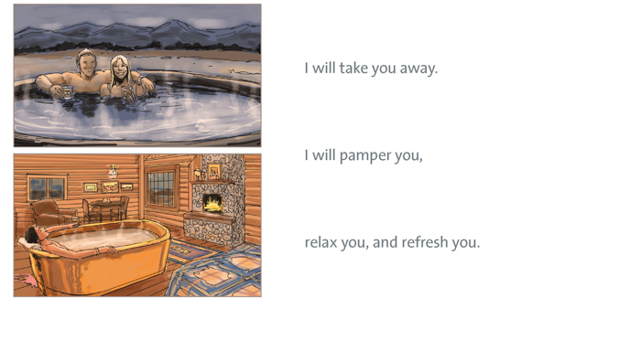

Slide 6
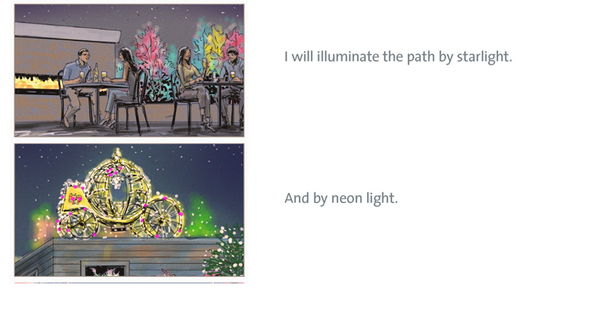

Slide 7
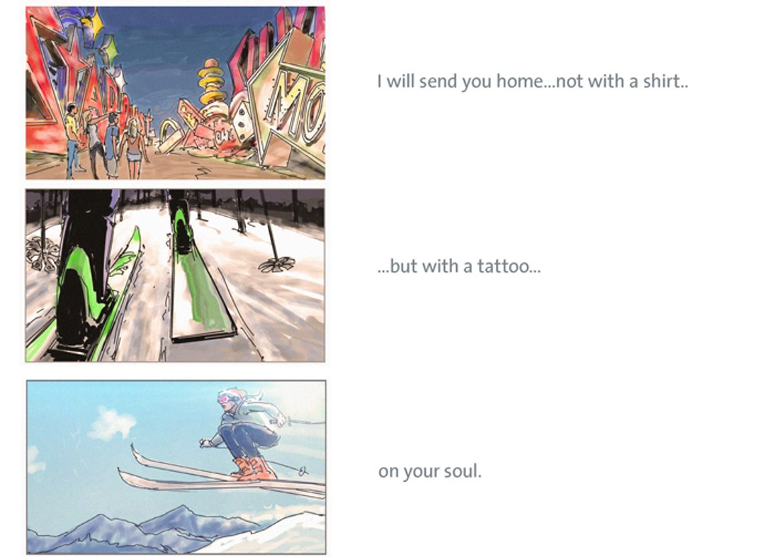

Slide 8
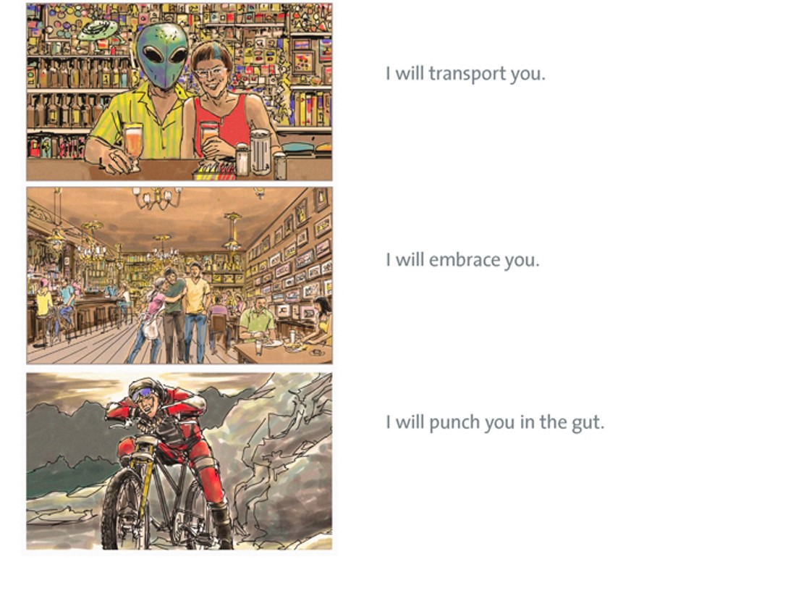

Slide 10
PLEASE PAUSE HERE

Slide 11
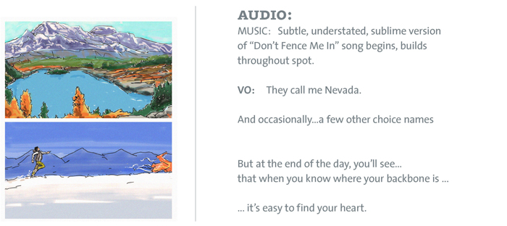

Slide 13
PLEASE PAUSE HERE

Slide 17
PLEASE PAUSE HERE

Slide 19
PLEASE PAUSE HERE

Slide 20
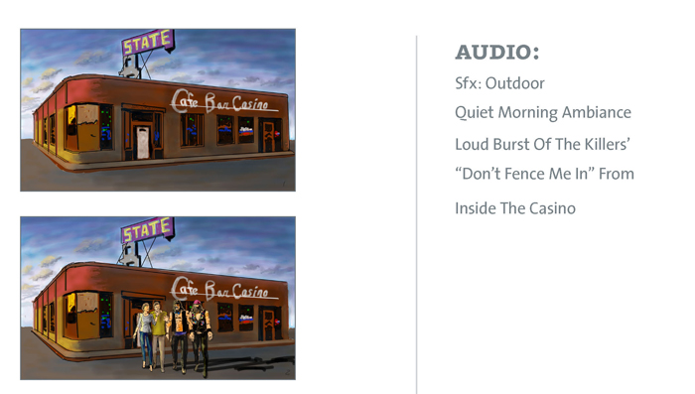

Slide 21
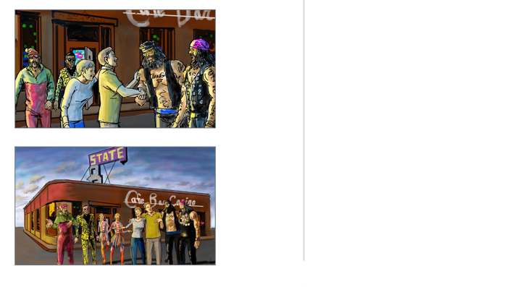

Slide 22
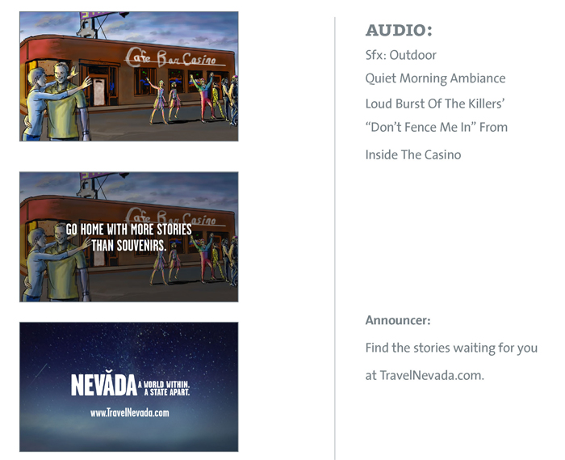

Slide 23
PLEASE PAUSE HERE

Slide 24
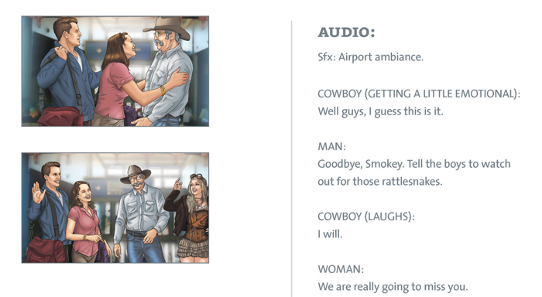

Slide 27
PLEASE PAUSE HERE

Slide 29
PLEASE PAUSE HERE

Slide 31
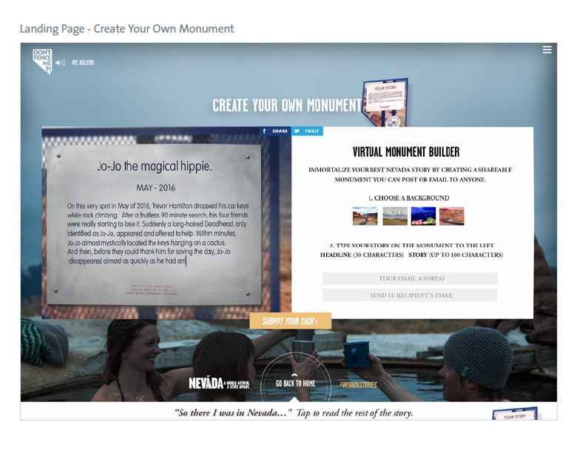

Slide 32
PLEASE PAUSE HERE

