Slide 1
The State of the American Traveler
Mobile Edition

Slide 2
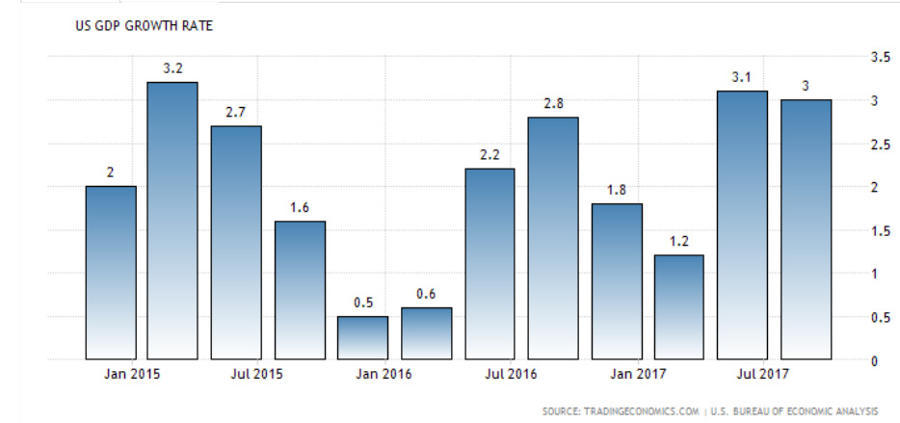
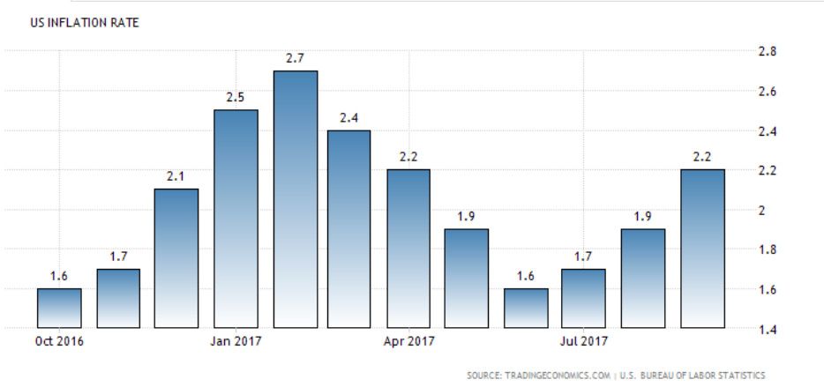
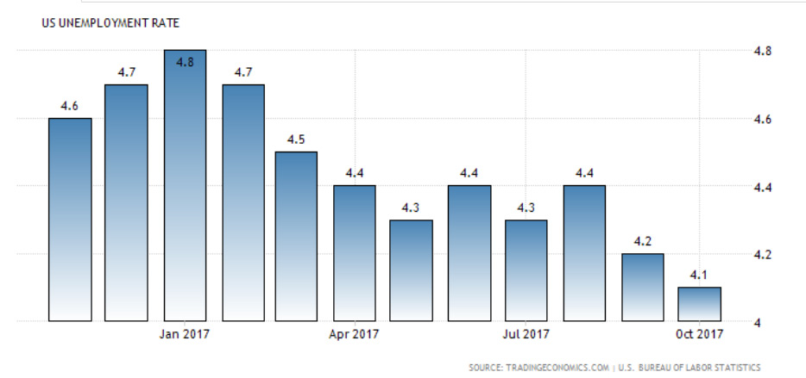
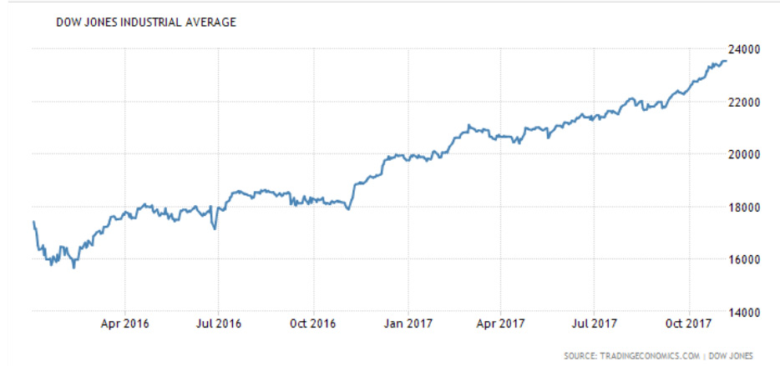
Current Economic Conditions

Slide 3
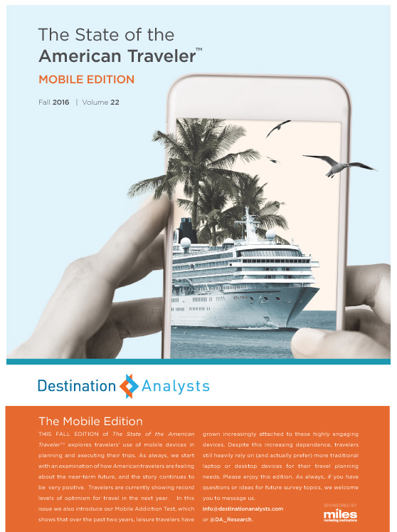
The State of the American Traveler
Online survey conducted since 2006
Survey invitation sent to a nationally representative sample of US adults
Total sample of 2,000 American leisure travelers
Examines traveler sentiment, motivations & behaviors
Quarterly project
The State of the American Traveler, Traveler Segments Edition, Destination Analysts, Inc. Fall 2017

Slide 4
American
Traveler Sentiment
October 2017

Slide 5
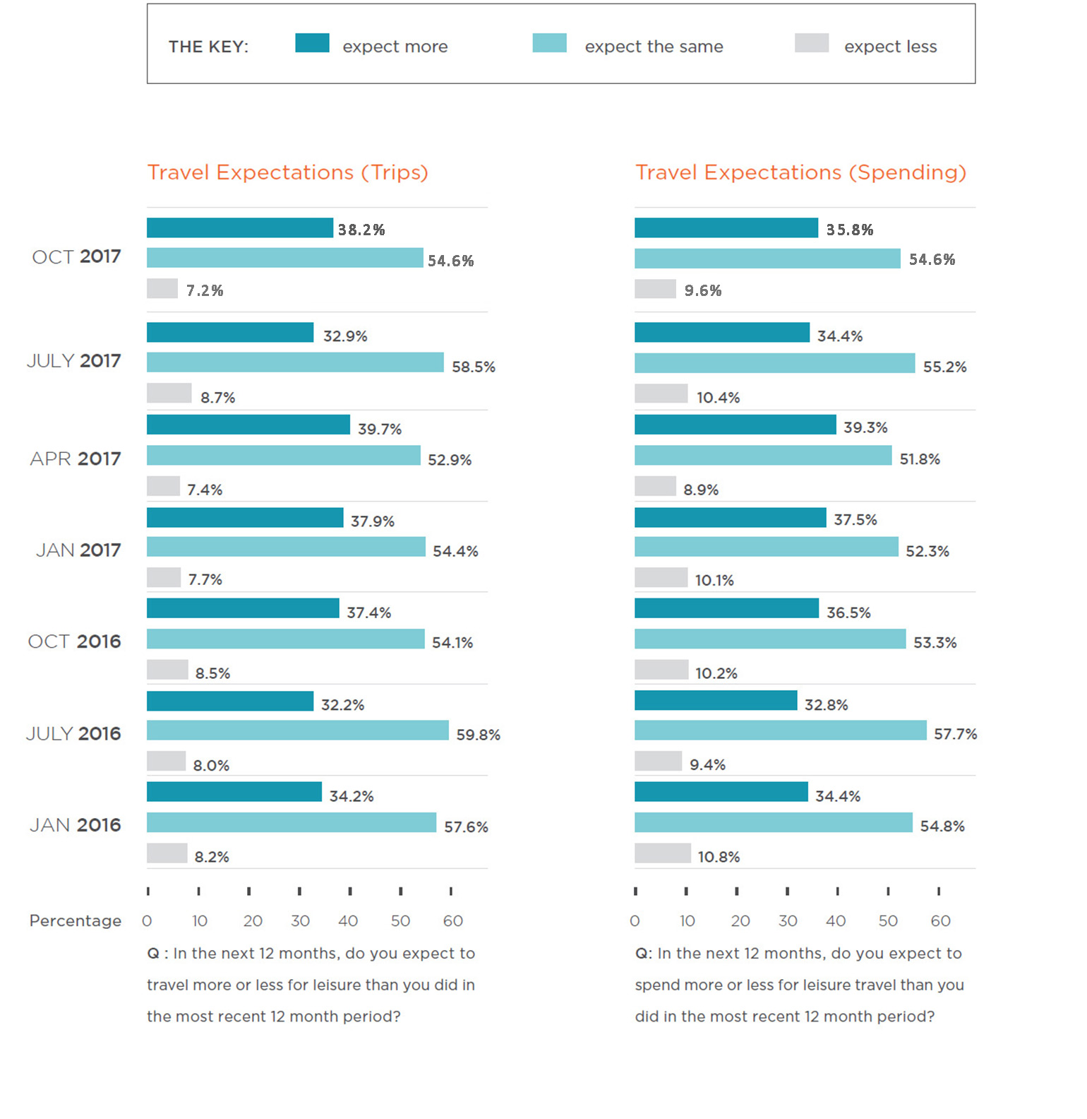
Current
Leisure Travel
Optimism
Trips & Spending
(Next 12 Months)

Slide 6
Impediments to Travel: Gasoline Prices
Percent of Leisure Travelers
The State of the American Traveler, Traveler Segments Edition, Destination Analysts, Inc. Summer 2017

Slide 7
Impediments to Travel: Airfare too Expensive
Percent of Leisure Travelers
The State of the American Traveler, Traveler Segments Edition, Destination Analysts, Inc. Summer 2017

Slide 8
Impediments to Travel: Personal Finances
Percent of Leisure Travelers
The State of the American Traveler, Traveler Segments Edition, Destination Analysts, Inc. Fall 2017

