Slide 1
THE state of the American traveler:
Mobile Edition
November 8, 2018

Slide 2
Chris Adams
David Reichbach
Head of Research and Insights Miles Partnership
Chris.Adams@MilesPartnership.com
Director of Analytics and Data Security Destination Analysts
dreichbach@DestinationAnalysts.com

Slide 3
Steven Paganelli
Head of Destination Marketing TripAdvisor

Slide 4
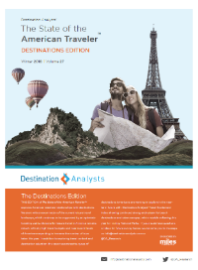
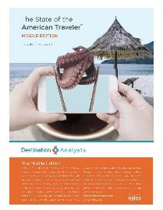
The State of the American Traveler: Mobile Edition
Research, slides and other resources will be available at
www.milespartnership.com/SAT
www.destinationanalysts.com
Notes:
The slide deck and recording will be available at this site, and the full research report will be available early next week.
You can also register for The State of the American Traveler Mobile Edition webinar at www.milespartnership.com/SAT

Slide 5
Thanks to:

Slide 6
DMA West Tech Summit & Vendor Showcase
March 20-22, 2019
Hyatt Regency Albuquerque
Visit Albuquerque | www.visitalbuquerque.org
Featured Presentation
Destination Analysts staff will present the findings
of the DMA West Foundation’s soon-to-be completed research study:
“Measuring Visitor Conversion from DMO Social Media Investment + Traveler Profiles
of DMO Social Media Audiences.”
Nineteen (19) western DMOs are participating in this research study. The combined (blind) findings will produce industry averages on DMO social media marketing impact and performance. This research will also gather important insights into DMO social media audiences, which deepen the industry’s understanding of these traveler profiles and their content desires.
Photo: Visit Spokane

Slide 7
Upcoming Events
December 5-6, 2018
Open to any/all DMO’s outside of Georgia
Buford, Georgia (North Atlanta)
March 19-21, 2019
STS’s Annual Conference
Daytona Beach, Florida
For more details, visit SoutheastTourism.org

Slide 8
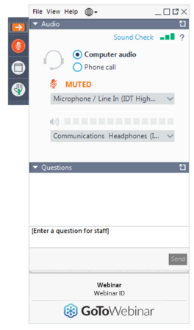
Choose to use computer audio or dial in by phone.
Open or close the control panel with the orange button.
How to participate
Have a question? Ask it here.
In case of “drop-off”, use your link to rejoin the webinar.
A Q&A session will be held at the end of today’s presentation,
Today’s webinar is being recorded and will be made available for viewing later.

Slide 9
Research: American Traveler Sentiment
Research: The Mobile Travel Planner
Spotlight: Insights from TripAdvisor
Additional Research & Resources
Agenda
Notes:
Here is the agenda for today – where we break the research presentations into two parts. Firstly, I will pass over to Dave for Destination Analysts’ latest research on how US travelers decide where to go? The motivations , interests and content that motivates them. Then Erin will join us with the Global Gallery of great Destination Content from around the world. I will share some an update on additional research and resources available to you all – and then Dave will finish off the webinar with a short research summary of Destination Analysts widely followed Travel Intentions and Outlook monitor for US travelers.

Slide 10
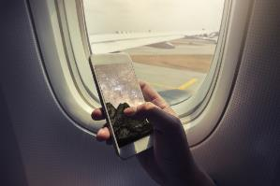
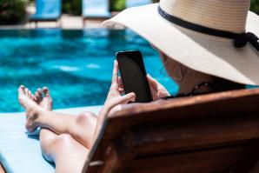
The State of the American Traveler
Mobile Edition

Slide 11
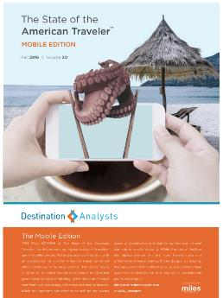
About The State of the American Traveler
Online survey conducted since 2006
Survey invitation sent to a nationally representative sample of US adults
Total sample of 2,000 American leisure travelers
Examines traveler sentiment, motivations & behaviors
Conducted quarterly
The State of the American Traveler, Traveler Segments Edition, Destination Analysts, Inc. Fall 2018

Slide 12
American Traveler Sentiment
October 2017

Slide 13
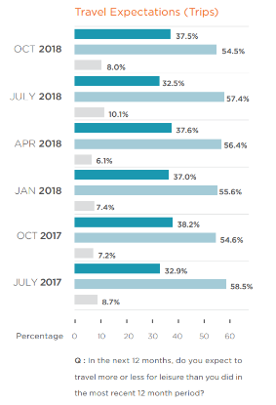
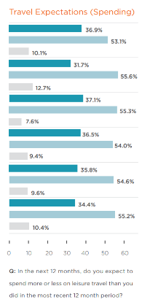
Current Leisure Travel Optimism
Trips & Spending (Next 12 Months)

Slide 14
Impediments to Travel: Airfare is Too Expensive
Percent of Leisure Travelers
The State of the American Traveler, Traveler Segments Edition, Destination Analysts, Inc. Fall 2017

Slide 15
Impediments to Travel: Gasoline Prices
Percent of Leisure Travelers
The State of the American Traveler, Traveler Segments Edition, Destination Analysts, Inc. Fall 2017

Slide 16
Impediments to Travel: Personal Finances
Percent of Leisure Travelers
The State of the American Traveler, Traveler Segments Edition, Destination Analysts, Inc. Fall 2017

Slide 17
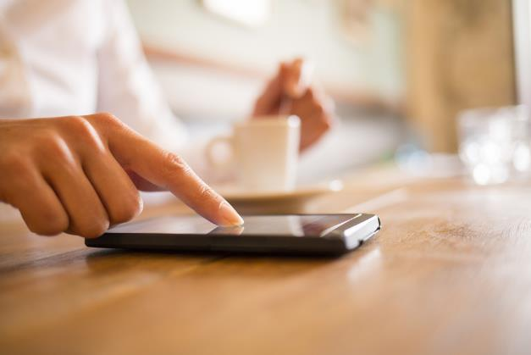
The Mobile Travel Planner

Slide 18
2015 | 2016 | 2017
94.0% | 94.2% | 95.8%

Slide 19
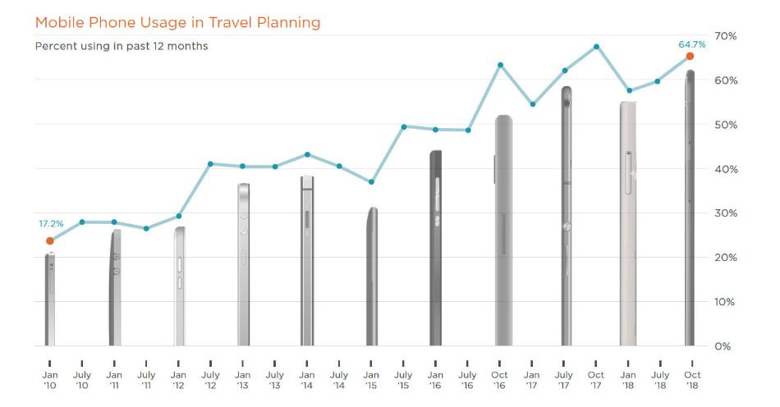

Slide 20
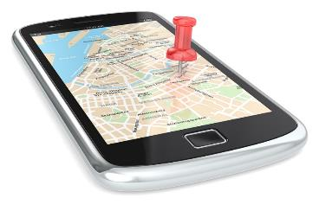
Executive Summary (cont.)
Mobile vs. Desktop Planning
Question: What percent of your leisure travel planning is typically done using each of the following before (and after) leaving for your trip?
Source: The State of the American Traveler, Destination Analysts, Inc.
Notes:
x

Slide 21
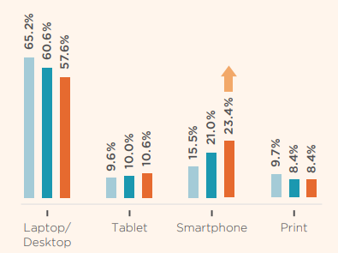
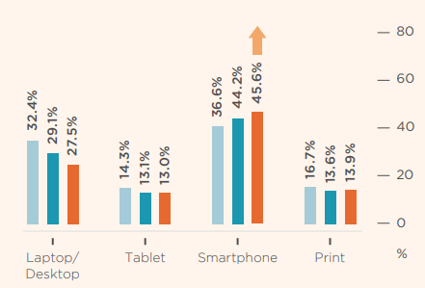

Slide 22
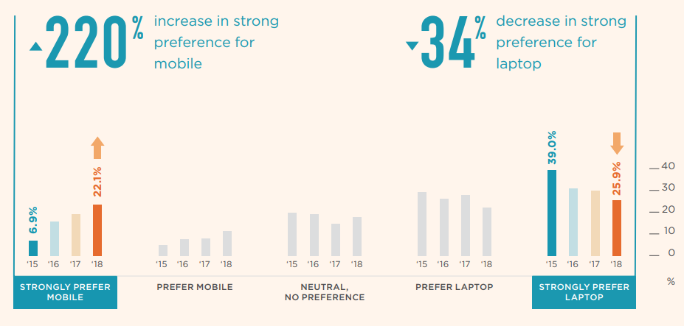

Slide 23
Planning Leisure Travel

Slide 24
Executive Summary (cont.)
Ease of Using Mobile Phone: Travel Research
Question: Please think exclusively about researching your travels PRIOR TO TRAVELING OR PURCHASING a travel product. In your experience, how easy is using your mobile phone to research and find travel information?
Source: The State of the American Traveler, Destination Analysts, Inc.
Notes:
x

Slide 25
Executive Summary (cont.)
Ease of Using Mobile Phone: Booking Travel
Question: Please think exclusively about MAKING TRAVEL PURCHASES using your mobile phone. In general, how easy do you find using your mobile phone to purchase or book travel products and services (hotels, flights, etc.)?
Source: The State of the American Traveler, Destination Analysts, Inc.
Notes:
x

Slide 26
Executive Summary (cont.)
Mobile Phones: Resources Used Before Traveling
Question: Please think about the last time you used a mobile phone to plan a leisure trip.
BEFORE actually booking your travel, which of the following resources did you use (on your mobile phone) to plan your trip?
Source: The State of the American Traveler, Destination Analysts, Inc.
Notes:
x

Slide 27
Executive Summary (cont.)
Mobile Phones: Resources Used While Traveling
Question: Please think about the trip where you last used a mobile phone to plan a leisure trip.
WHILE traveling WITHIN YOUR DESTINATION (City, Region, State), which of the following resources did you use (on your mobile phone) to plan your trip?
Source: The State of the American Traveler, Destination Analysts, Inc.
Notes:
x

Slide 28
Executive Summary (cont.)
Researching & Mobile Phones
Question: While planning a leisure trip the PAST TWELVE (12) MONTHS, which of the following have you researched using your mobile phone?
Source: The State of the American Traveler, Destination Analysts, Inc.
Notes:
x

Slide 29
Executive Summary (cont.)
Purchasing & Mobile Phones
Question: Now, please think about purchases made with your mobile phone. In the PAST TWELVE (12) MONTHS, which of the following have you purchased using your mobile phone?
Source: The State of the American Traveler, Destination Analysts, Inc.
Notes:
x

Slide 31
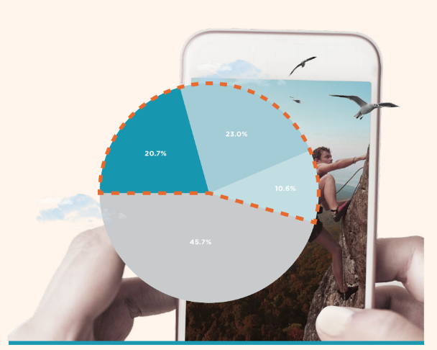
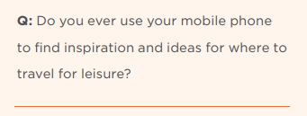
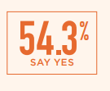
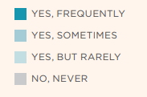

Slide 32
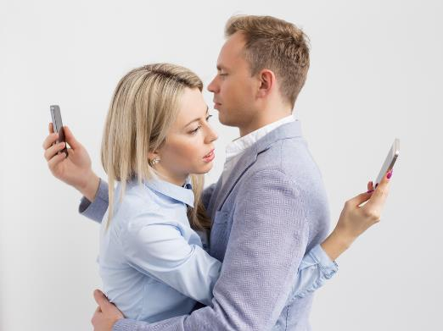
Destination Analysts’
Mobile Addiction Test
Scored on 6 questions on:
Behaviors and emotions regarding mobile phones
Based on standard addiction self-assessment test methodologies
Each respondent scored from 1 to 100
Measured four times:
January 2015
October 2016
October 2017
October 2018

Slide 33
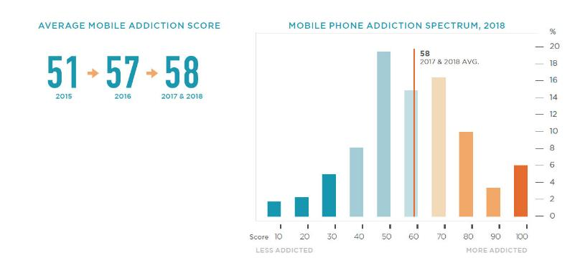

Slide 34
Very Likely
Likely
Somewhat
Likely
Unlikely
Very
Unlikely

Slide 37
THANK YOU!

Slide 38
Q&A

Slide 39
The State of the American Traveler: Mobile Edition
Research, slides and other resources will be available at
www.milespartnership.com/SAT
www.destinationanalysts.com
Notes:
The slide deck and recording will be available at this site, and the full research report will be available early next week.
You can also register for The State of the American Traveler Mobile Edition webinar at www.milespartnership.com/SAT

Slide 40
Thank you!
THE state of the American traveler:
Mobile Edition
November 8, 2018

